Slide 1
Law of Demand

Slide 2
Law of Demand
Law of Demand states that there is an inverse relationship between the price and quantity demanded of a commodity, keeping other factors constant or ceteris paribus. It is also known as the First Law of Purchase.
There are several other factors besides the price of the given commodity that affect the quantity demanded of a commodity. Therefore, in order to understand the separate influence of one factor affecting the demand, it is essential that the other factors are kept constant. Hence, under the Law of Demand, it is assumed that other factors are constant.

Slide 3
Assumptions of Law of Demand
The assumptions on which the Law of Demand is based are as follows:
The price of substitute goods does not change.
The price of complementary goods also remains constant.
The income of the consumer does not change.
Tastes and preferences of the consumers remain the same.
People do not expect the future price of the commodity to change.

Slide 4
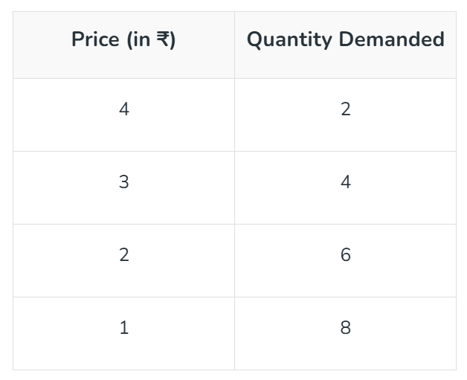
Demand Schedule

Slide 5
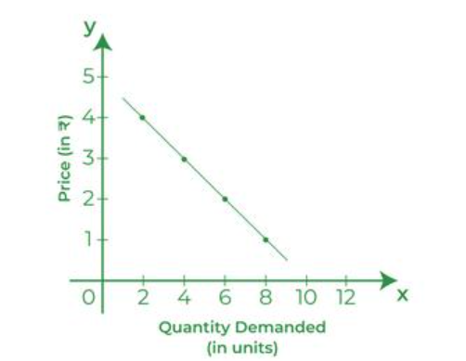
Demand Curve

